Slide 1
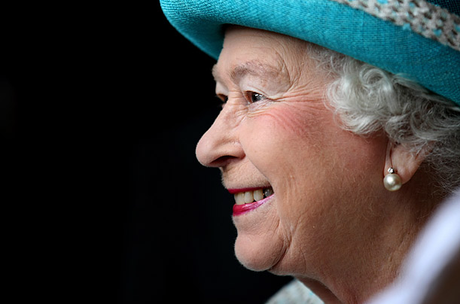
«The Queen Elizabeth II as the greatest symbol of unity and stability of the United Kingdom»

Slide 2
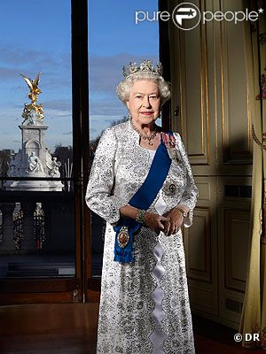
What does it mean to be the Queen of the UK? What does it mean to be a monarch for 60 years? Humanity does not think of this wonderful old lady has so much power in her hands that any modern dictator has never dreamed of.

Slide 3
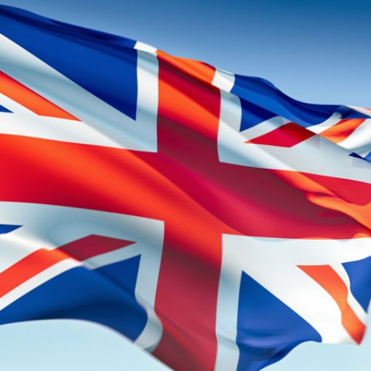
The role of the British Monarchy
To date, Britain remains one of the few countries where there is still a monarchy. It plays a very minor role in the political life of the country but it is its face and can be called a symbol of England.

Slide 4
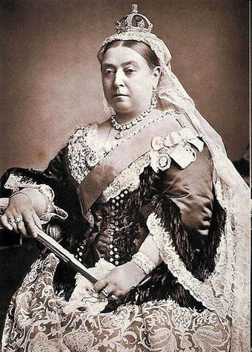
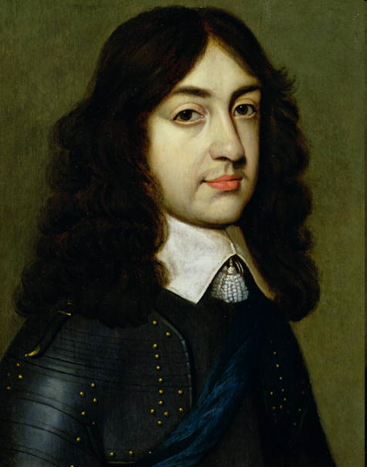
The monarchy in England was going through different times. It was absolute and limited, loved and despised. This is largely dependent on the individual, which at the time was on the throne. Elizabeth was strict, conservative, Victoria, who was on the throne for 63 years, Charles II, known as humorist. They all had different attitudes to the monarchy.

Slide 5
“As long as we have a monarchy, a pound and a private visa - British joke. - We can not disturb the revolution and the financial crises in Europe. The state which honors its traditions, always protects its people.”

Slide 6
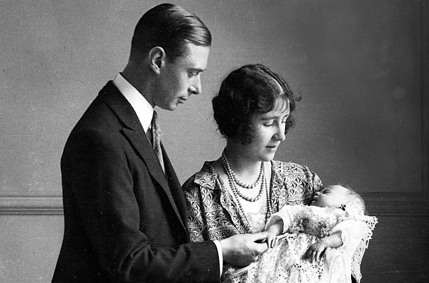
Public life of Elizabeth II
The Queen Is born
On April 21, 1926, the Duke and Duchess of York (later King George VI and Queen Elizabeth, the Queen Mother) welcomed their daughter Elizabeth Alexandra Mary to the world.

Slide 7
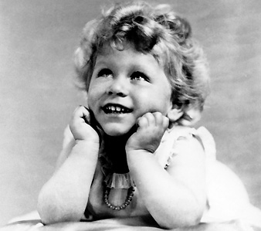
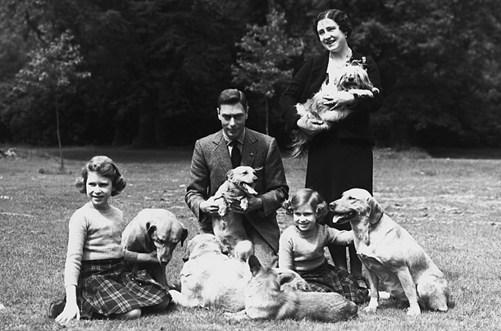
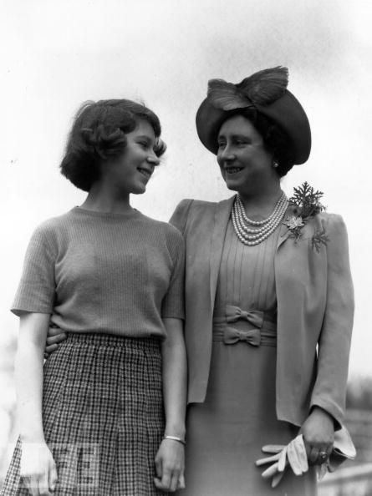

Slide 8
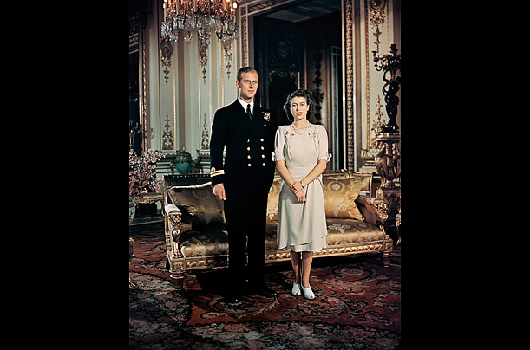
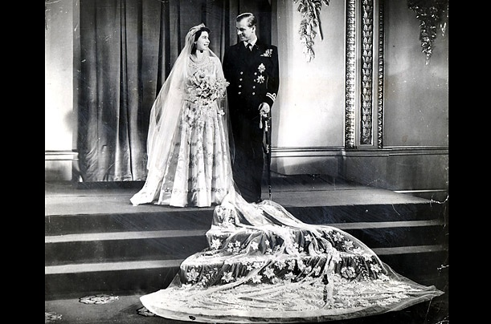
Royal Engagement and Wedding
Princess Elizabeth stands with her fiancé, Lieutenant Philip Mountbatten, Prince of Greece and Denmark, at Buckingham Palace on Aug. 19, 1947.
The couple went to the altar on the 20th of November, 1947

Slide 9
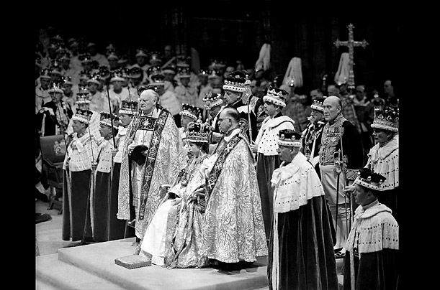
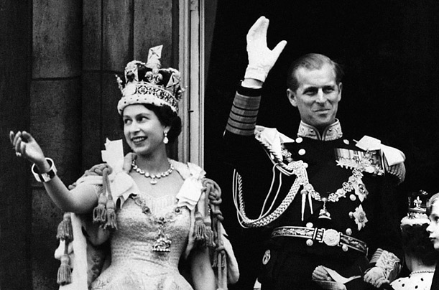
The Queen's coronation
Queen Elizabeth II came to the throne at the age of 25 on the 6th of February after her father’s death. But the Official Queen's coronation took place on June 2, 1953 at Westminster Abbey in London. It marked the first time a royal coronation was televised.

Slide 10
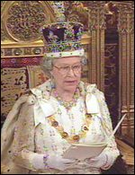
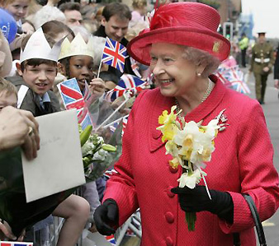
The Queen and Policy
The Queen's Role
Head of State
Head of the Armed Forces
Head of the Church of England
Government Duties
Represents the Nation
Visits

Slide 11
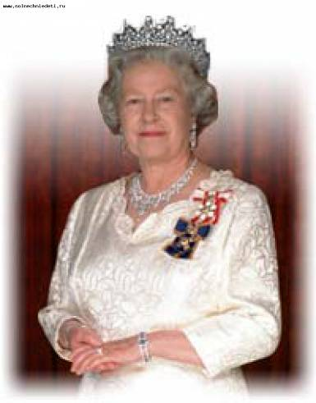
Today the Queen is not only head of State, but also an important symbol of national unity. The royal title in Britain is: 'Elizabeth the Second, by the Grace of God of the United Kingdom of Great Britain and Northern Ireland and of Her other Realms and Territories Queen, Head of the Commonwealth, Defender of the Faith'

Slide 12
The most interesting facts about the Queen’s life
The Queen is the fortieth monarch since William the Conqueror obtained the crown of England and the second longest serving monarch.
In 1969 the first film about the royal family was created and shown on television.
In 1997, there was an official royal site.(http://www.royal.gov.uk)

Slide 13
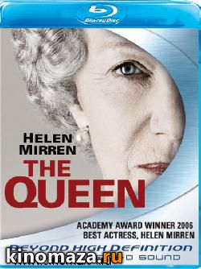
In 2009, the Queen created "Twitter" and a year later - in 2010 - "Facebook" But to be a friend of the Queen on "Facebook" is impossible.
Biographical film "The Queen“ (2006) directed by Stephen Frears, taken jointly by France, Britain and Italy. It describes the life of British royal family after the tragic death of Princess Diana.

Slide 14
The Queen has nine royal throne - one in the House of Lords, two - in Westminster Abbey, and six - in the throne room at Buckingham Palace.
The Queen has different hobbies: dogs, horses, walking in the countryside, Scottish country dancing, hats…
The Queen celebrated her Diamond Jubilee in 2012.

Slide 15
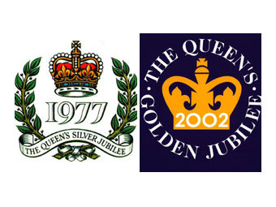
1977 The Queen’s Silver Jubilee Emblem 2002 The Queen’s Golden Jubilee Emblem 2012 The Queen’s Diamond Jubilee Emblem

Slide 16
Diamond Jubilee coins

Slide 17
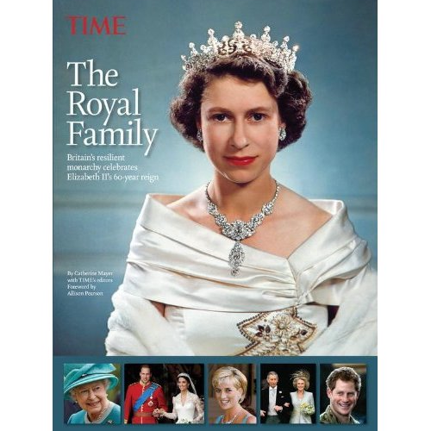
Diamond Jubilee books

Slide 18
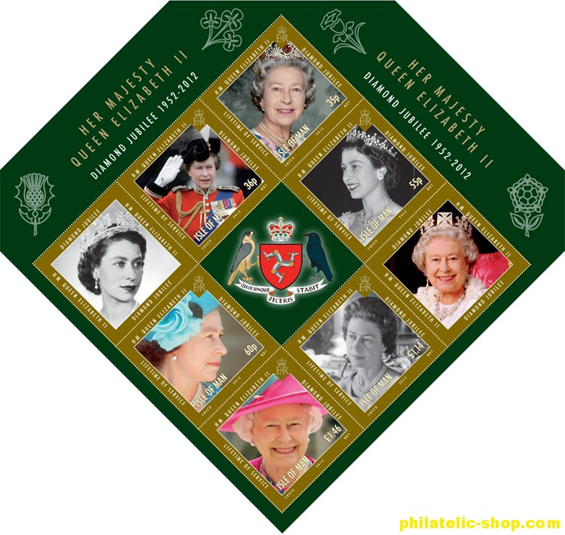
Royal Mail in honor of Diamond Jubilee has released a set of stamps featuring the Queen
.

Slide 19
and opened an exhibition of portraits of Her Majesty: “Sixty photographs of sixty years”

Slide 20
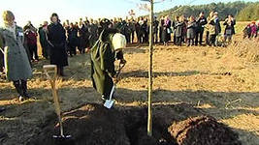
A gift for a Diamond anniversary
As a gift for a Diamond anniversary to the throne The Queen asked to plant six million trees. Before working with a spade, the Queen said: "Let's make our wood better than the Siberian taiga".

Slide 21
Conclusion
The British monarchy is still alive and well for many centuries. It is certainly the oldest management institute of the United Kingdom
The Queen Elizabeth II is the oldest monarch in British history. She has changed the British monarchy. She devotes her life to serving the people, possessing her own and unique style.
The 60th anniversary of ascension to the throne of Elizabeth II is a significant date in the history of Britain.
The world rapidly changes, empires fall and ruling dynasties are replaced. But there is English which today has spoken all over the world.

Slide 22
Thanks for attention!

