Slide 1
Германова Ю.А. учитель английского зыка

Slide 3
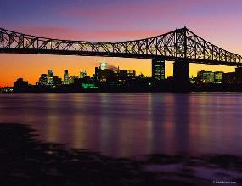
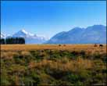
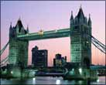
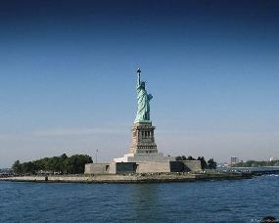
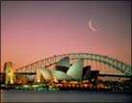
English is the native language in:

Slide 4
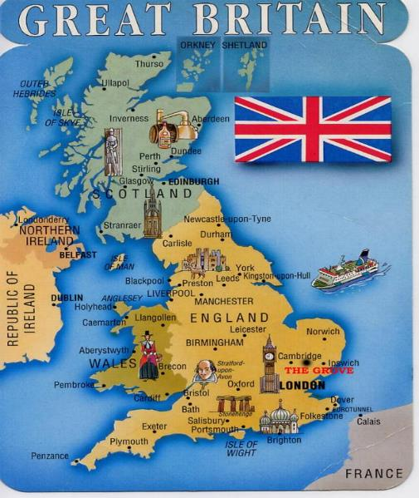
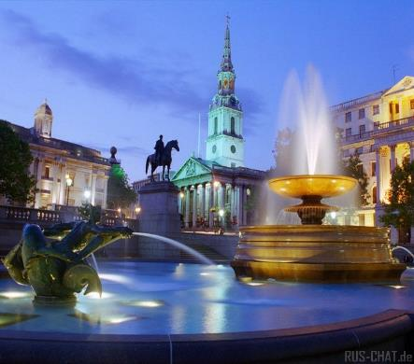
The United Kingdom of Great Britain and Northern Ireland
The capital of Great Britain is London.
People – the British

Slide 5
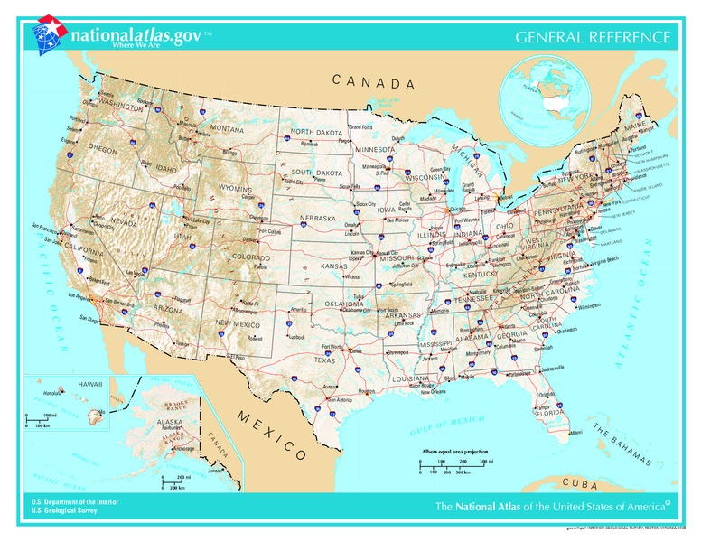
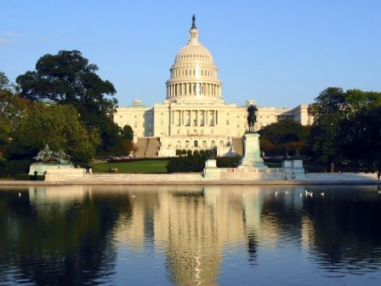
The United States of America
The capital of America is Washington.
People –
the Americans

Slide 6
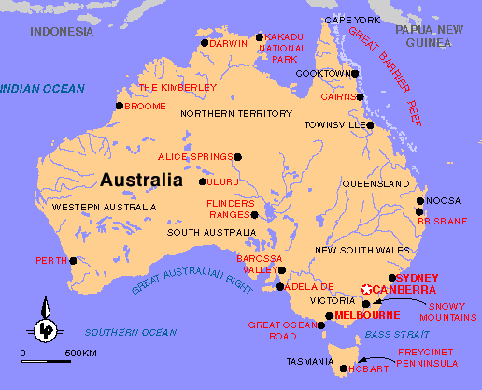
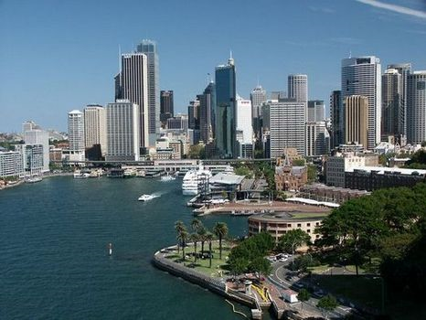
Australia
The capital of Australia is Canberra.
People –
the Australians

Slide 7
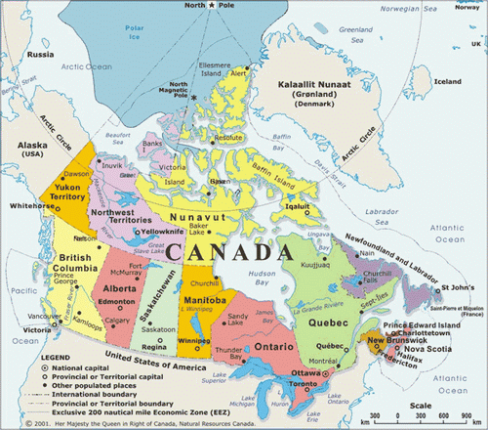
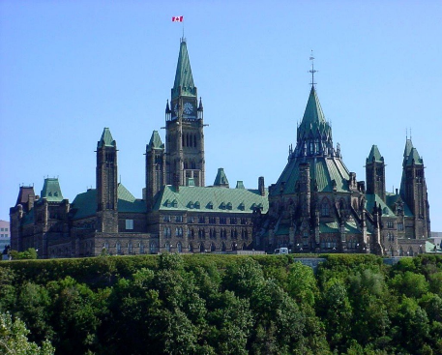
Canada
The capital of Canada is Ottawa
People –
the Canadians

Slide 8
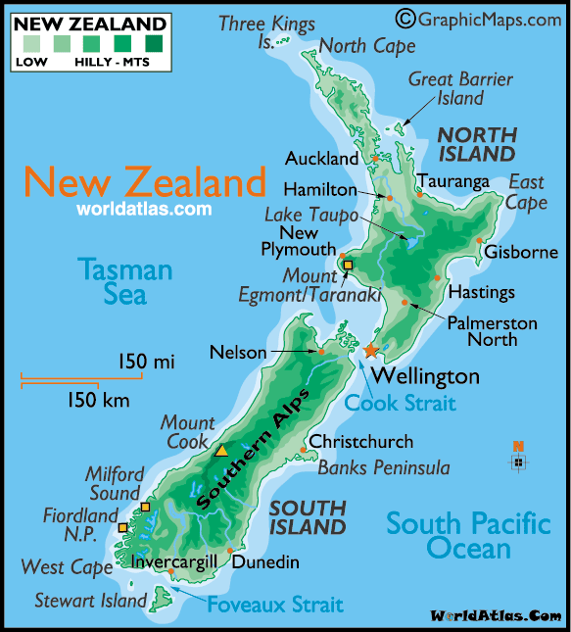
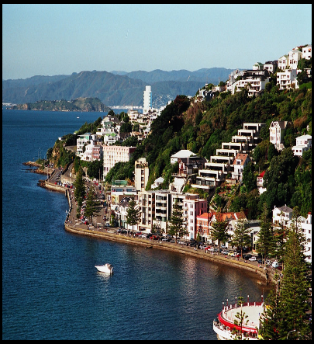
New Zealand
The capital of New Zealand is Wellington.
People –
the New Zealanders

Slide 9
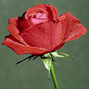
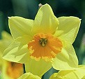
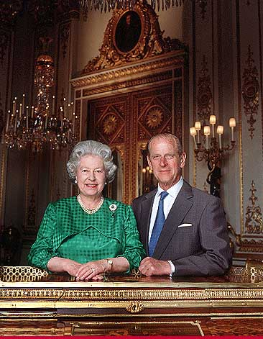
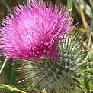
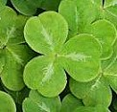
British symbols The Queen of Great Britain is Elizabeth II. Her husband is Duke of Edinburgh.
The rose is the national emblem of England.
The national flower of Scotland is the thistle.
The national flower of Wales is the daffodil.
The national flower of Northern Ireland is the shamrock.

Slide 10
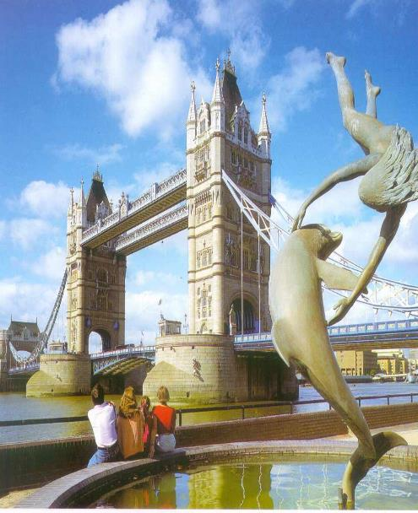
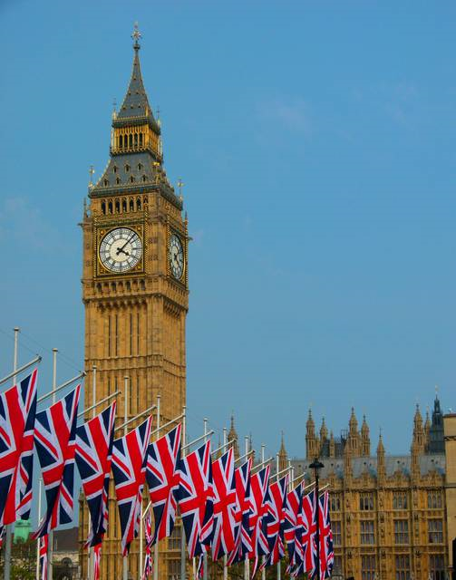
Tower Bridge - Big Ben- the most famous bridge in London the big clock tower

Slide 11
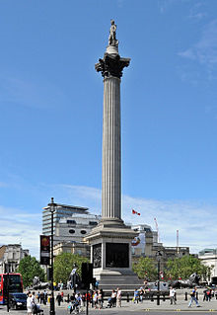
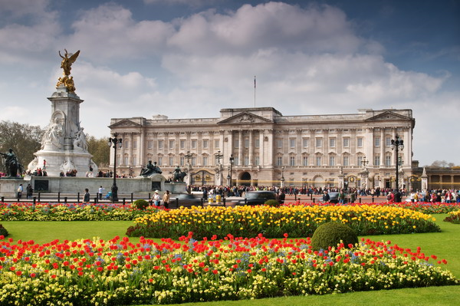
Trafalgar Square Buckingham Palace In the middle of the square This is the Queen’s home. there is Admiral Nelson’s Column.

Slide 12
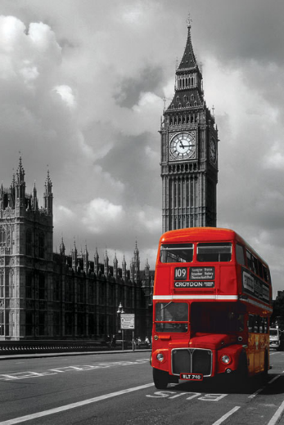
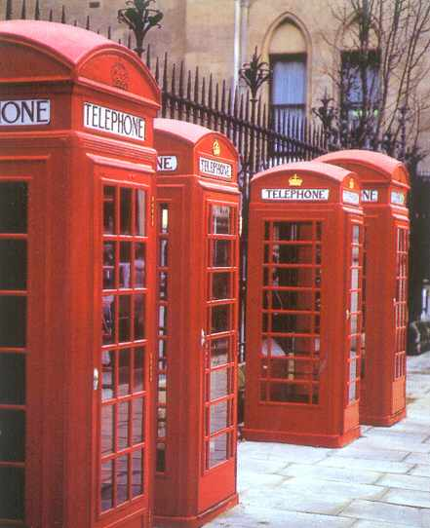
Double-deckers Telephone booths There are big red buses called From here you can call your friends. double-deckers in London.

Slide 13
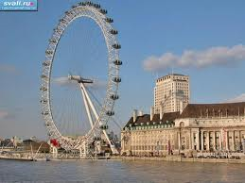
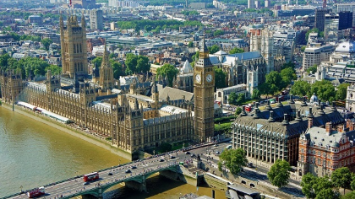
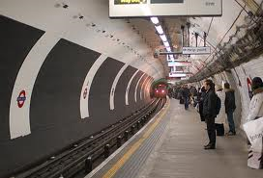
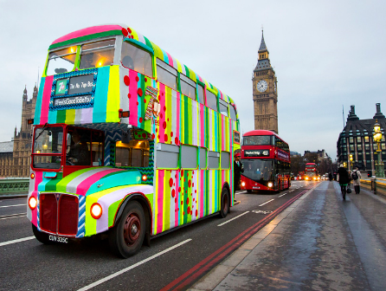
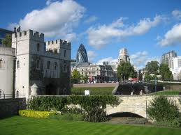
ENJOY SIGHTSEEINGS of LONDON !!!

Slide 14
Revision
What English-speaking countries do you know?
Answer: They are … , … , … , … , … .
What are their capitals?
Answer: …… is the capital of ……. .
What floral symbols of the UK do you know?
Answer: They are … , … , … , … .

